Slide 1
MINI PROJECT EDA (fifa dataset)
- By JAIKEERTHIVELAN R

Slide 2
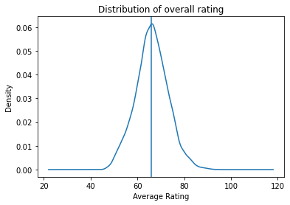
Plotting the distribution of Overall rating for all players.
Inference: Most of the players ratings are present in range 66 to 66.5

Slide 3
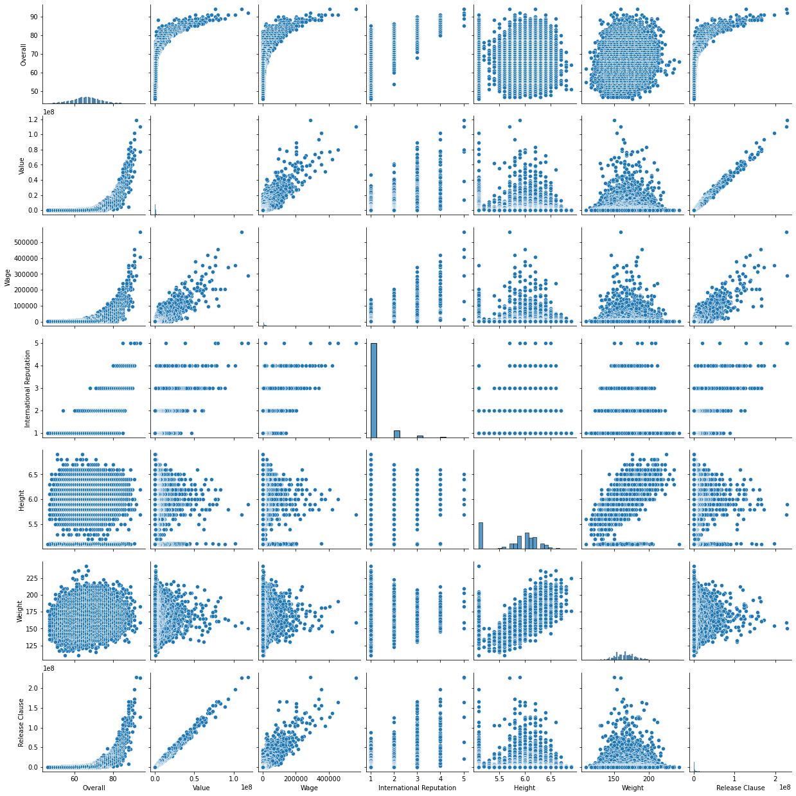
Pair plots for the following variables: Overall, Value, Wage, International Reputation, Height, Weight, Release Clause

Slide 4
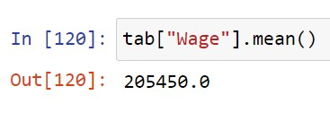
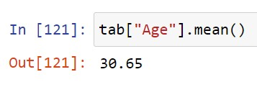
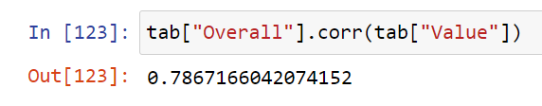
Generated a table (tab) containing the top 20 players ranked by Overall score and whose contract expires in 2020.
Average wage for that set of players
Average age for that set of players
Correlation value between Overall and Value

Slide 5
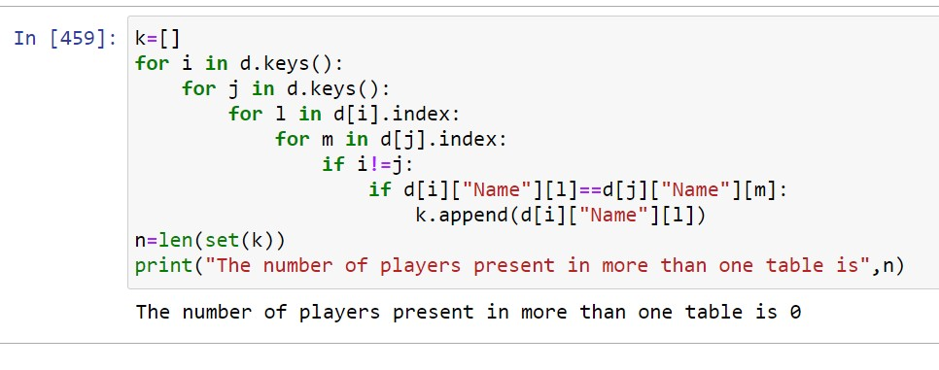
Generated tables within a dictionary (d) containing the top 5 players by Overall rating for each unique position there are totally 27 tables in the dictionary each key represents each unique position
There are no players present in more than two tables

Slide 6
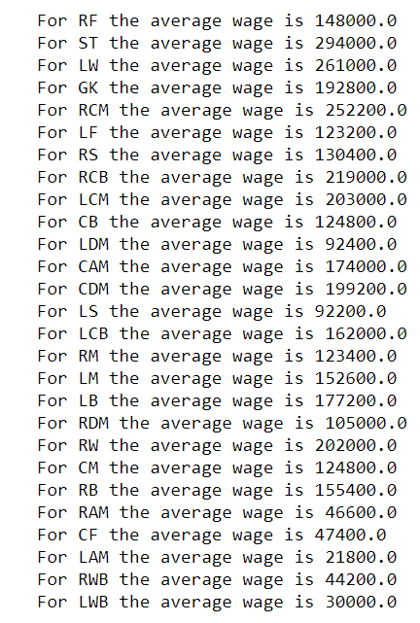
Average wage for top 5 in every position
Inference: The average wage expected by ST position is high when compared to other positions and the average wage for LAM is the lowest

